Slide 1

Faculty of Design and Innovation
Creative and Innovative Studies
(CRET101)
Week 1: Lecture 1
ALL RIGHTS RESERVED
No part of this Document should be produced without written approval from Limkokwing University of Creative Technology Sierra Leone

Slide 2
DEFINING CREATIVITY
The process of generating Original ideas that have Value
The generation of original ideas or a new way of doing things.
Creativity is the act of turning new and imaginative ideas into reality.
Creativity is characterised by the ability to observe the world in new ways, to find hidden patterns, to make connections between seemingly unrelated phenomena, and to generate solutions.

Slide 3
A famous psychologist named Robert Sternberg has argued that Creativity requires three different types of intelligence.
Synthetic intelligence: the ability to see or analyze a problem in a new, unique way.
Analytic intelligence: the ability to analyze relationships or associations among ideas and then apply these associations to the problem at hand.
Practical intelligence: the ability to come up with new ideas or ways of solving a problem based on the feedback of other people or by learning from past experience.

Slide 4
“Our Creative Imaginations must have something to work on. We do not form new ideas from out of nothing. The raw materials are all there, the creative mind only sees possibilities in them or connections that are invisible to less
Creative minds”.
ADAIR J. 2009

Slide 5
Activity 1: Summary and discussion

Slide 6
WHY CREATIVITY IS IMPORTANT FOR YOU?
A recent World Economic Forum research predicted the top 10 skills that would be in demand by 2020. Complex problem solving has emerged as the top skill on the list.
Traditional system of education in Sierra Leone is obsolete hence
the high unemployment rate.

Slide 7
CREATIVE THINKING
A way of looking at problems or situations from a fresh perspective that suggests unconventional solutions.
Creative thinking can be stimulated both by an unstructured process such as brainstorming, and by a structured process such as lateral thinking.

Slide 8
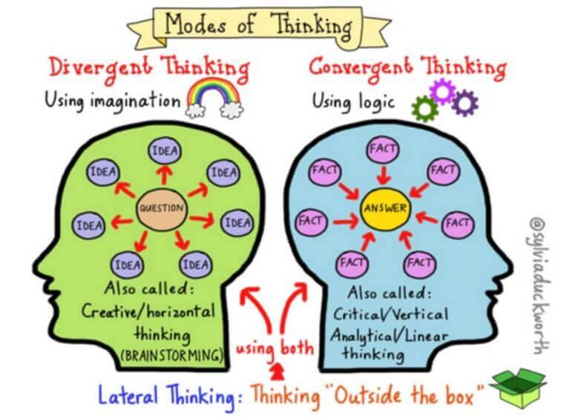
Divergent, Convergent Thinking and Lateral Thinking

Slide 9
Divergent Thinking
“Divergent thinking” refers to the problem solving strategy characterized by multiplicity of possible solutions in an attempt to determine the one that works. It usually happens in a free-flowing, spontaneous manner, where multiple creative ideas are engendered and evaluated.

Slide 10
A diverse number of potential solutions are studied in a brief span of time, and unconventional connections may be drawn. Once the stage of divergent thinking is complete, information and ideas are structured and organized using convergent thinking.
Brainstorming and free writing are some of the processes that involve divergent thinking.

Slide 11
Convergent Thinking
Convergent thinking is a problem solving technique involving the bringing together different ideas from different participants or fields to determine a single best solution to a lucidly defined problem.
In other words, this is a kind of thinking that concentrates on finding out the single best or frequently, correct solution to a problem or answer to a question.

Slide 12
Lateral thinking
Refers to using both Convergent and Divergent Thinking, solving problems through an indirect and creative approach, using reasoning that is not immediately obvious and involving ideas that may not be obtainable by using only traditional step-by-step logic. The term was coined in 1967 by Edward de Bono.

Slide 13
Differences
Convergent is straightforward and simple, divergent thinking is complex while lateral thinking uses both.
Convergent is the type of thinking we do when solving a well-defined, straightforward, correct answer to a problem. Convergent thinking is used when there is a simple, correct answer to a question. For example, what's the capital of England? The answer is London. If you knew the answer, you used convergent thinking.

Slide 14
Creativity is not relevant to convergent thinking because you don't have to be creative to know the answer to this problem; all you have to do is come up with the stated, factual answer. When you're in school and you take a multiple-choice test you are probably using convergent thinking - you might be supplying definitions for terms or remembering a person's name that goes with a particular theory.

Slide 15
Activity 2: Summary and discussion

Slide 16
DEVELOPING CREATIVE THINKING
Curiosity: Leads to Discovery
Observation: Leads to Understanding
Intuition: The ability to understand something
instinctively, without the need for conscious reasoning.

Slide 17
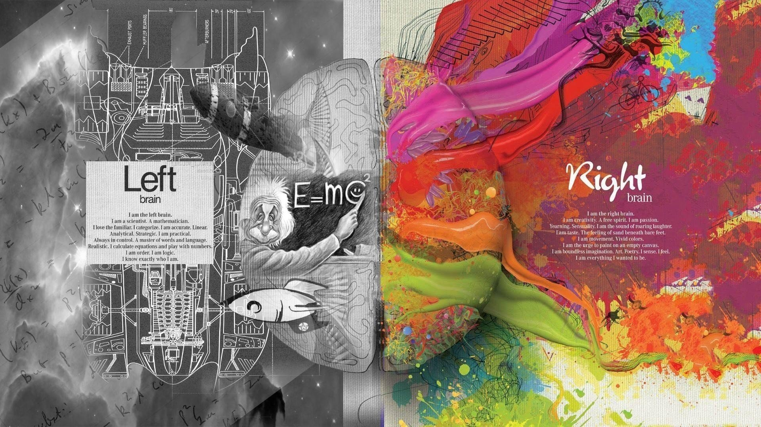
LOGIC
LISTS
LINEARITY
WORDS
NUMBERS
SEQUENCE
ANALYSIS
RHYTHM
COLOR
IMAGINATION
DAY DREAM
DIMENSION
SPACIAL AWARENESS
MUSIC
ALL RIGHTS RESERVED
No part of this Document should be produced without written approval from Limkokwing University of Creative Technology Sierra Leone

Slide 18
Activity 3: Summary and discussion

Slide 19
Activity 4: Who’s that ?
In this activity, students will work in pair.
They need to find out information on their partner and draw the image of their partner based on their interpretation of the information that they had gathered.

